Slide 1
Animation 3D
3D
Abrar Alabdulwahab and An Eui Hyun

Slide 2
Contents:
Intro 3d
How it works
Where do we use it
Practice

Slide 3
Before We Start Lets Learn The Basics

Slide 4
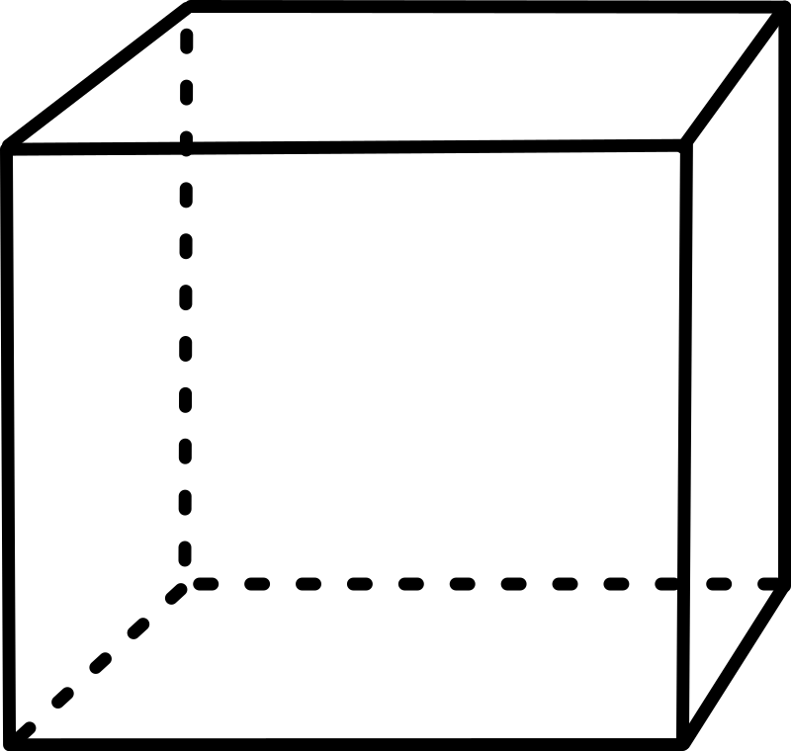
What are Dimensions?
Face
__Width
Vertex
Height__
__Length
Notes:
Dimensions in mathematics are the measure of size or distance of an object or region or space in one direction. Measuring the Length, Width and height.

Slide 5
What are 1D 2D 3D?
__Width
Height__
Height__
__Length
__Length
Notes:
1D is just a line from point A to B
2D is measuring the X and Y (Width and Height)
3D is measuring the X , Y , Z
(Width , Height, and Depth)

Slide 6
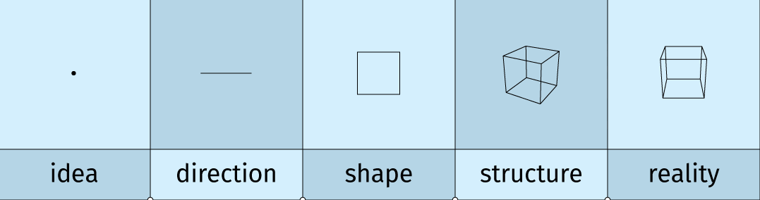
What are 1D 2D 3D?

Slide 7
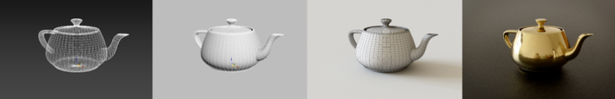
What is 3D image?
Wireframe
Final product
Constructed digitally
Notes:
3D image is a digitally constructed image. This can come in many different ways such as photographs or films.
Left side is the wireframe of a 3D image tea pot being constructed digitally and slowly progressing into a final product.

Slide 8
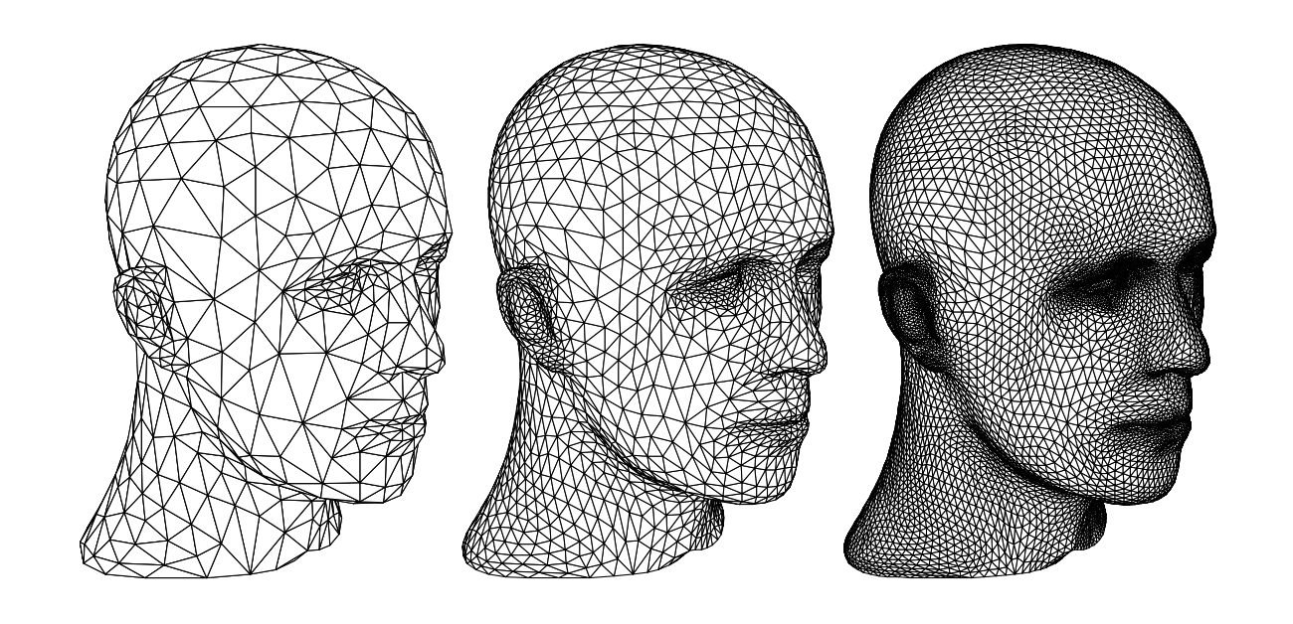
3D Meshes
Collection of vertices, edges and faces
Notes:
In 3D computer graphics and solid modeling, a polygon mesh is a collection of vertices, edges and faces that defines the shape of a polyhedral object. The variety of operations performed on meshes may include: Boolean logic, smoothing, simplification, and many others. Algorithms also exist for ray tracing, collision detection, and rigid-body dynamics with polygon meshes. If the mesh's edges are rendered instead of the faces, then the model becomes a wireframe model.

Slide 9
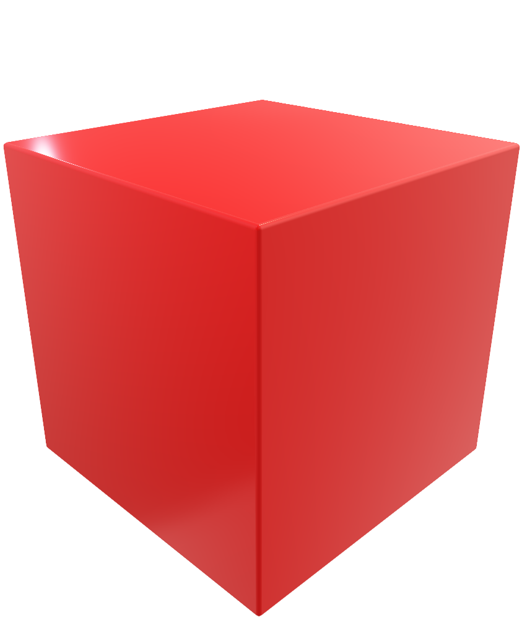
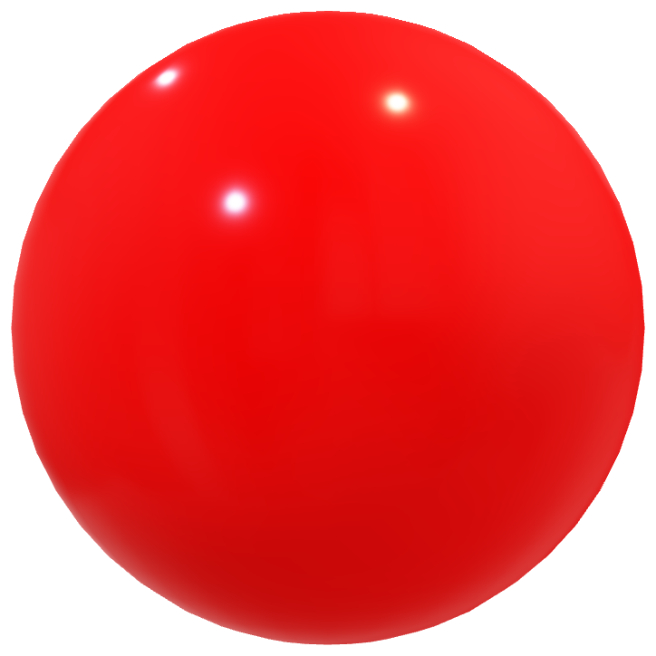
Subdivision
Shaving each corner
Notes:
There are a simple formula to subdivision the polygon. In a way its like shaving each corner until the it becomes a smoother surfaces.
Gouraud shading
Phong shading
Is also used to smoothen the edges when the edges are noticeable.

Slide 10
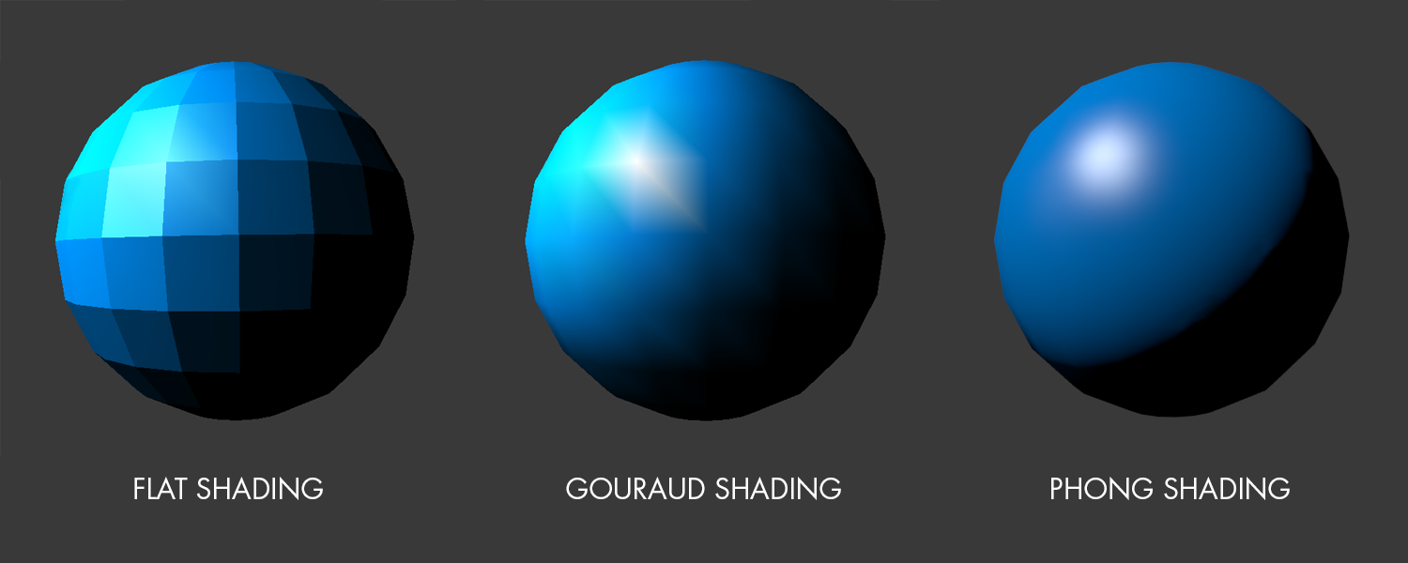
Subdivision
Gouraud shading
Phong shading
Notes:
There are a simple formula to subdivision the polygon. In a way its like shaving each corner until the it becomes a smoother surfaces.
Gouraud shading
Phong shading
Is also used to smoothen the edges when the edges are noticeable.

Slide 11
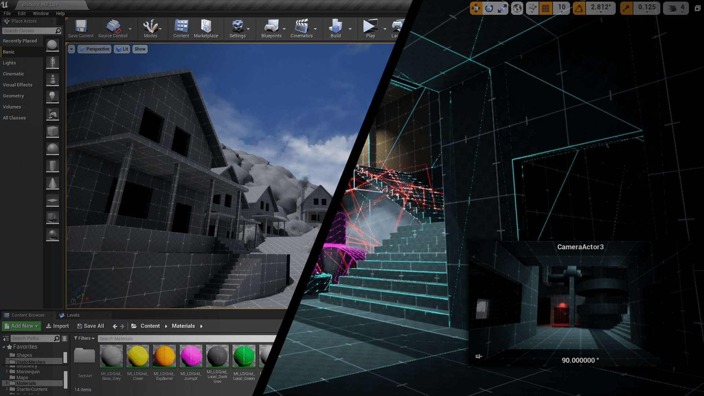
Game Designers
Notes:
Game designers have to carefully balance model fidelity vs. polygon count, because if the count goes too high, the framerate of an animation drops below what users perceive as smooth depending on the specification. For this reason, there are algorithms for simplifying meshes as well.

Slide 12
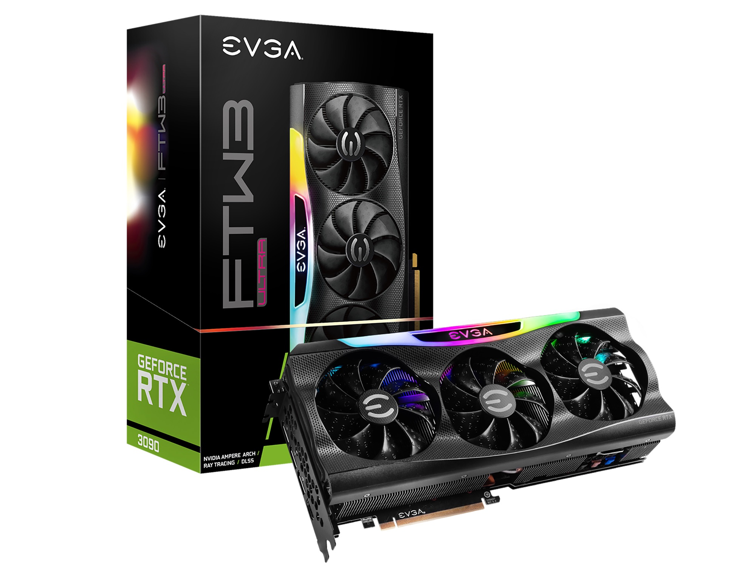
Graphics Card
Notes:
Graphics Card are a powerful tool when working with 3D objects and animation. Meshes lives inside this graphic card and it process 100,000 polygons a second.

Slide 13
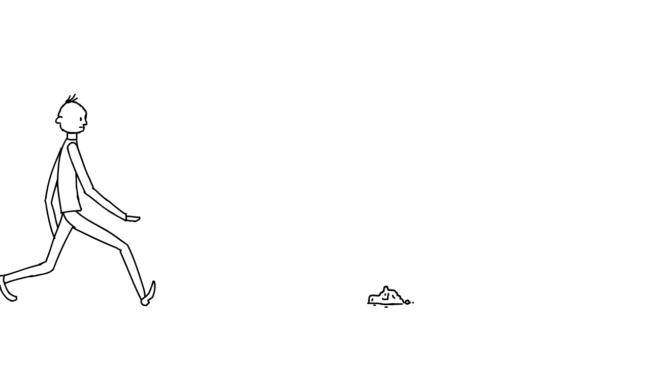
3D Animation
Notes:
Animation means to make things full of life or vigor; liveliness.
Some say its the technique of photographing successive drawings or positions of puppets or models to create an illusion of movement when the movie is shown as a sequence.
So Combined that with the definition of 3D image.
A digitally constructed photograph or drawing that is full of life creating the illusion of movement when a video is shown.

Slide 14
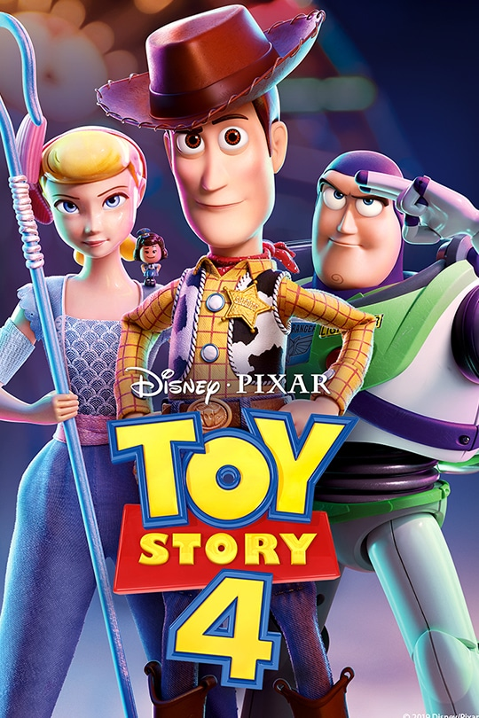
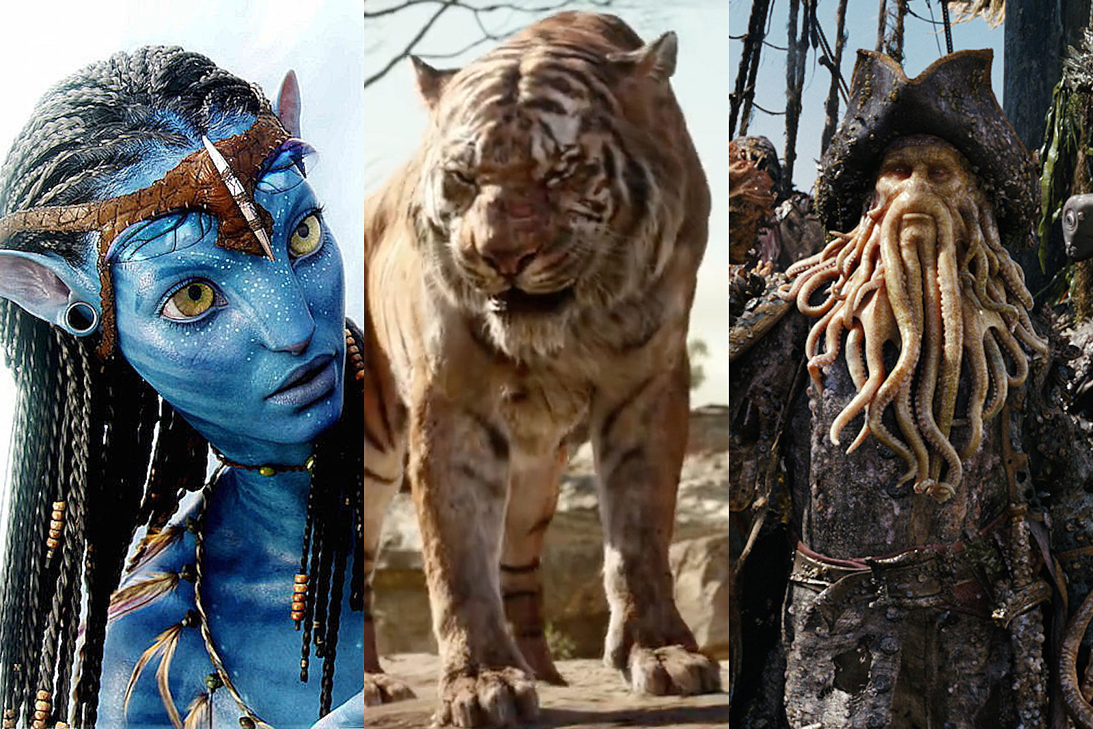
Why people use 3D animation?
Notes:
People use 3D to provide users with realistic replica of the object for quality control purposes. Such as…

Slide 15


Who uses 3D image for animation?
Notes:
A lot of people and companies use 3D image for animation.
Such companies that use a lot of 3D computer graphics are, for Example Walt Disney and Universal Pictures.

Slide 16
Now lets begin!

Slide 17

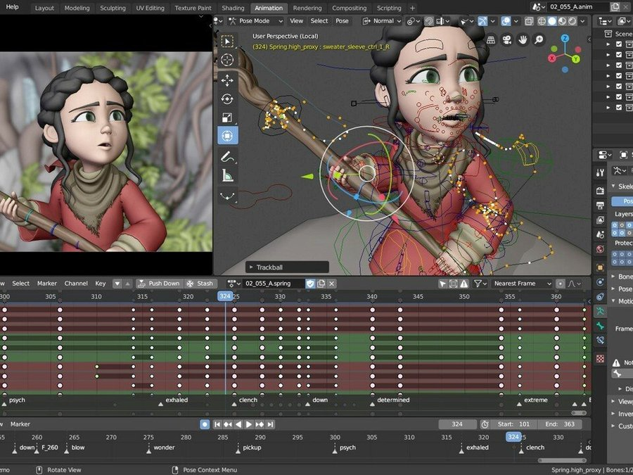
Where can we apply 3D images?
Notes:
We can apply 3D in many places such as, Blender:
Blender 3D Software is a computer graphics software that is used to develop 2D and 3D animated movies, games computer graphics, digital art, visual effects, and much more. Blender also uses python open source to make things work correctly inside blender.
Maya Autodesk:
Maya by Autodesk is one of the most popular 3D application offered by Autodesk. It helps with organizations and animators develop 3D models, animated videos and movies. You can also add visual effects. Maya also use python codes and MEL script.
and Python.

Slide 18

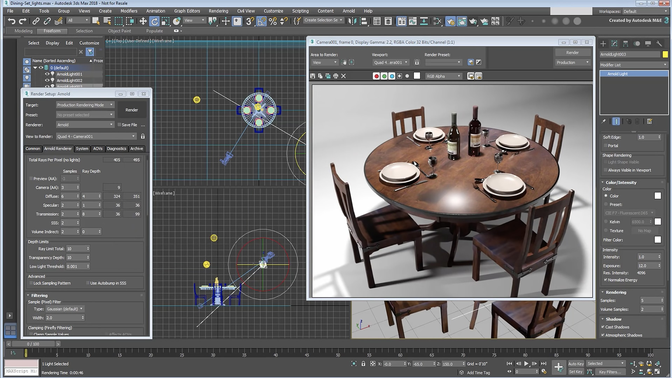
Where can we apply 3D images?
Notes:
We can apply 3D in many places such as, Blender:
Blender 3D Software is a computer graphics software that is used to develop 2D and 3D animated movies, games computer graphics, digital art, visual effects, and much more. Blender also uses python open source to make things work correctly inside blender.
Maya Autodesk:
Maya by Autodesk is one of the most popular 3D application offered by Autodesk. It helps with organizations and animators develop 3D models, animated videos and movies. You can also add visual effects. Maya also use python codes and MEL script.
and Python.

Slide 19

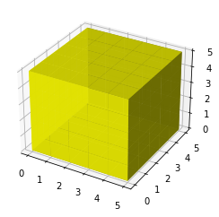
Where can we apply 3D images?
Notes:
We can apply 3D in many places such as, Blender:
Blender 3D Software is a computer graphics software that is used to develop 2D and 3D animated movies, games computer graphics, digital art, visual effects, and much more. Blender also uses python open source to make things work correctly inside blender.
Maya Autodesk:
Maya by Autodesk is one of the most popular 3D application offered by Autodesk. It helps with organizations and animators develop 3D models, animated videos and movies. You can also add visual effects. Maya also use python codes and MEL script.
and Python.

Slide 20
Python 3D image
from mpl_toolkits.mplot3d import Axes3D
Scatter
Surf
line
mesh
Notes:
In Python we can apply mpl_toolkits and import mplot3d.
mpl_toolkits.mplot3d provides basic 3D plotting (Scatter, Surf, line, mesh) tools. Its not the fastest or the completed 3D library but it can do some light works like our examples we prepared today.

Slide 21
3D
Scatter Plot

Slide 22
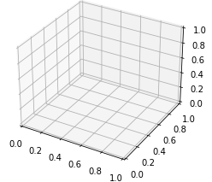
import matplotlib.pyplot as plt ax = plt.axes(projection='3d') plt.show() import matplotlib.pyplot as plt ax = plt.axes(projection='3d') ax.set_xlabel('X') ax.set_ylabel('Y') ax.set_zlabel('Z') plt.show()
Notes:
Then how can we create the 3d figure? Same way??
No it has a spical code.
Any gussing?
Ok so to create a 3d fuger, we use this code: ax = plt.axes(projection='3d')

Slide 23
3D
Cube

Slide 24
import matplotlib.pyplot as plt from mpl_toolkits.mplot3d import Axes3D import numpy as np axes = [5, 5, 5] data = np.ones(axes, dtype=np.bool) alpha = 0.9 colors = np.empty(axes + [4], dtype=np.float32) colors[:] = [1, 1, 0,alpha] ax = plt.axes(projection='3d’) ax.voxels(data, facecolors=colors)
3D Cube
Notes:
OK so starting with the needed libraries and this project first of all we need to import matplotlib pyplot as a PLT which is as we know this library can make us able to creates a figure, creates a plotting area in a figure, plots some lines in a plotting area, decorates the plot
Once we use this library we can, a three-dimensional axes can be created by passing the keyword projection='3d' to any of the normal axes creation routines:
ones creates an array full of ones, just like zeros. np.zero()
Alpha for the viziablety.
Create an array without initializing entries.
Ok now let me show you something and I want you to guess what the output will be:
If we add this code what will happen?
Add this edgecolors=‘gray’ then the edg can be gray
Add colors[0] = [1, 0, 0, alpha] # red
colors[1] = [0, 1, 0, alpha] # green
colors[2] = [0, 0, 1, alpha] # blue
colors[3] = [1, 1, 0, alpha] # yellow
colors[4] = [1, 1, 1, alpha]
Give a several colors.

Slide 25
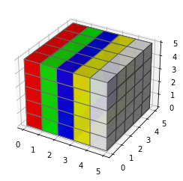
axes = [5, 5, 5] data = np.ones(axes, dtype=np.bool) alpha = 0.9 colors = np.empty(axes + [4], dtype=np.float32) colors[0] = [1, 0, 0, alpha] colors[1] = [0, 1, 0, alpha] colors[2] = [0, 0, 1, alpha] colors[3] = [1, 1, 0, alpha] colors[4] = [1, 1, 1, alpha] fig = plt.figure() ax = fig.add_subplot(111, projection='3d') ax.voxels(data, facecolors=colors, edgecolors='gray')
Notes:
Ok now let me show you something and I want you to guess what the output will be:
If we add this code what will happen?
Add this edgecolors=‘gray’ then the edg can be gray
Add colors[0] = [1, 0, 0, alpha] # red
colors[1] = [0, 1, 0, alpha] # green
colors[2] = [0, 0, 1, alpha] # blue
colors[3] = [1, 1, 0, alpha] # yellow
colors[4] = [1, 1, 1, alpha]
Give a several colors.

Slide 26
3D
Animation

Slide 27
import matplotlib.pyplot as plt from mpl_toolkits.mplot3d import axes3d from numpy import sin, cos, pi, outer, ones, size, linspace a = linspace(0, 2 * pi) b = linspace(0, pi) x = 10 * outer(cos(a), sin(b)) y = 10 * outer(sin(a), sin(b)) z = 10 * outer(ones(size(a)), cos(b)) frames = 26 for n in range(frames): fig = plt.figure(figsize=(10, 10)) ax = fig.add_subplot(111, projection='3d') ax.plot_surface(x, y, z, color=('r')) ax.set_xticks([]) ax.set_yticks([]) ax.set_zticks([]) ax.set_xlim(-8,8) ax.set_xlim(-8,8) ax.set_xlim(-8,8) plt.savefig(f"{n}.png") plt.close() x += 1 from PIL import Image images = [Image.open(f"{n}.png") for n in range(frames)] images[0].save('ball.gif', save_all=True, append_images=images[1:], duration=100, loop=0)

Slide 28
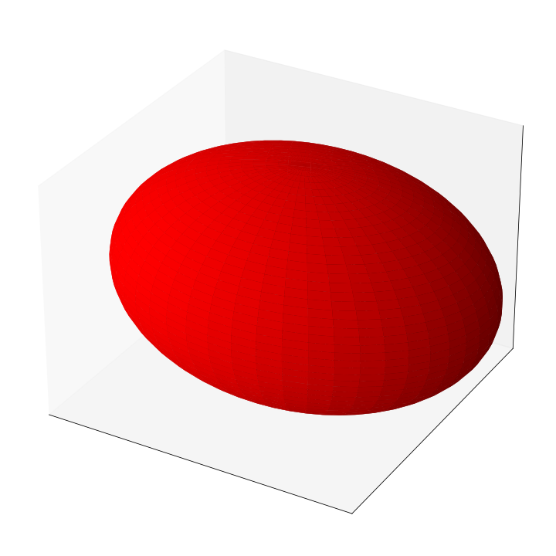
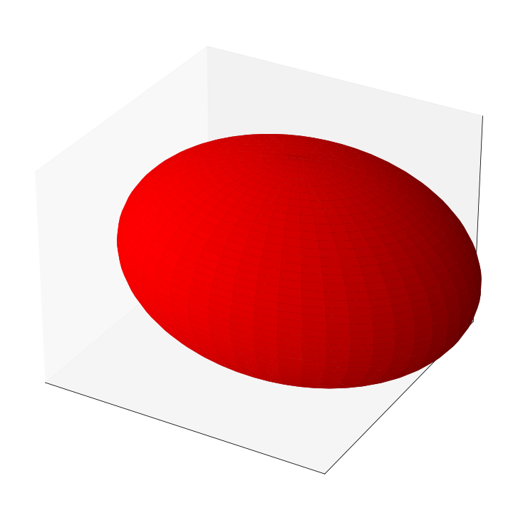
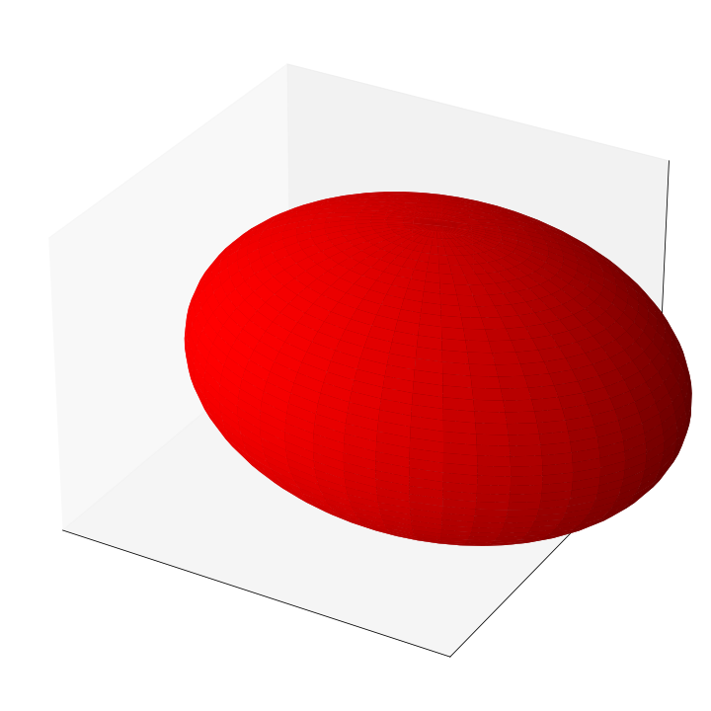
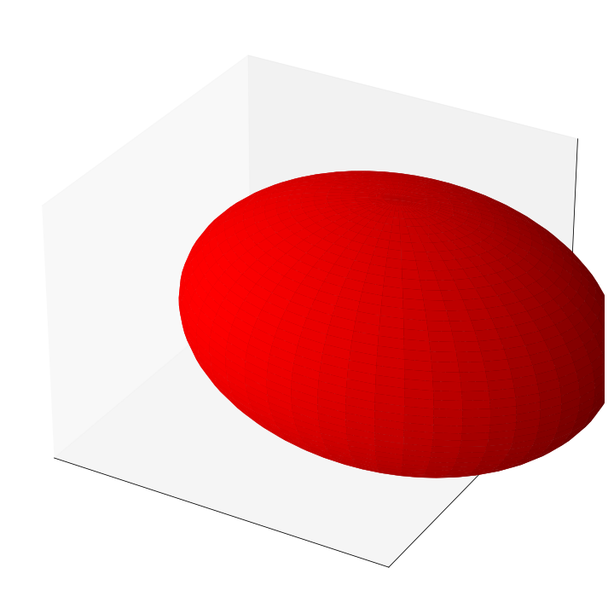
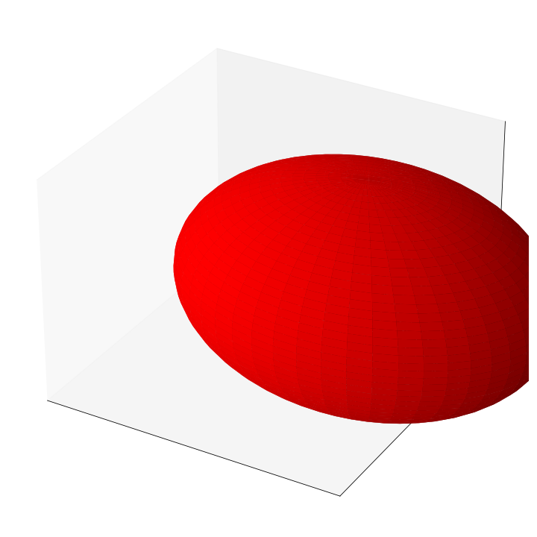
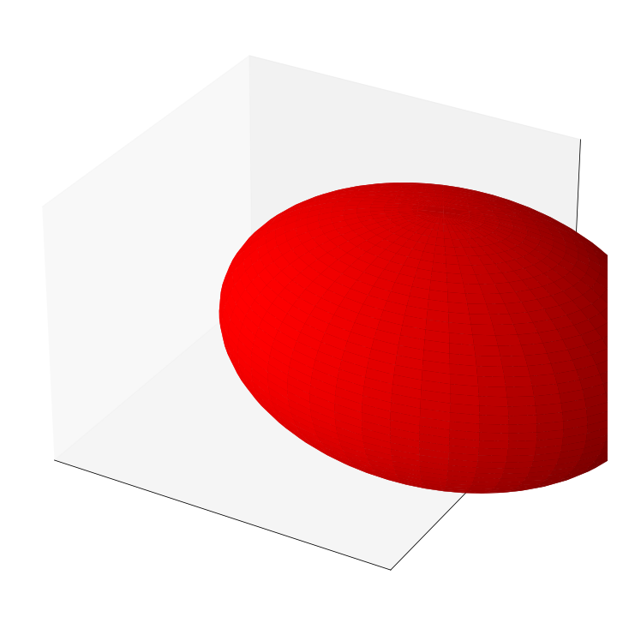
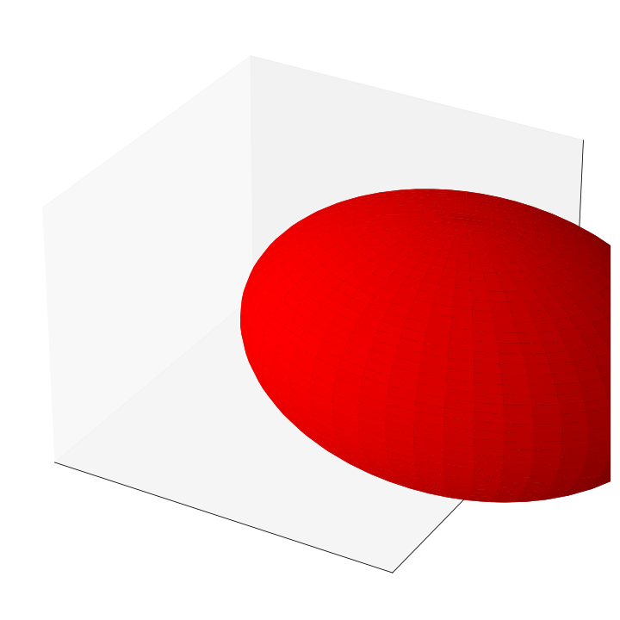
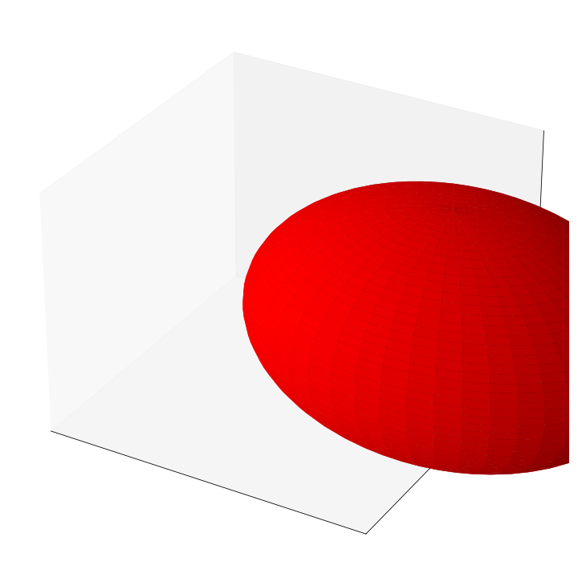
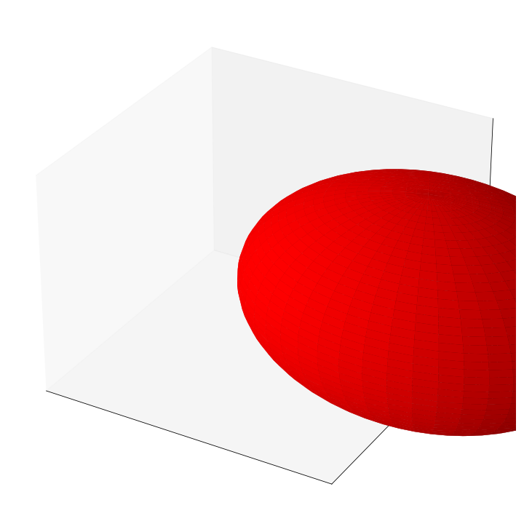
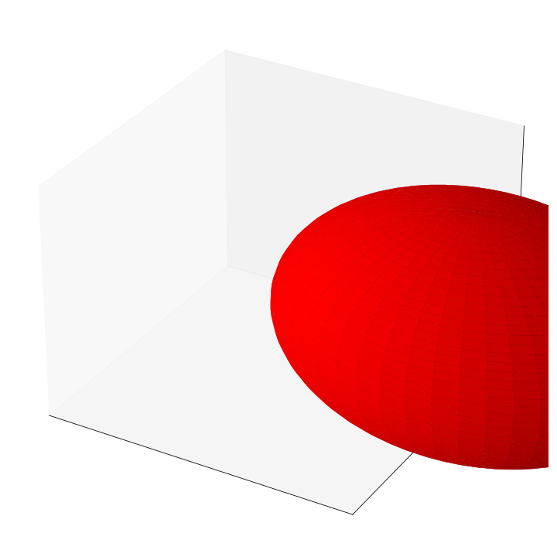
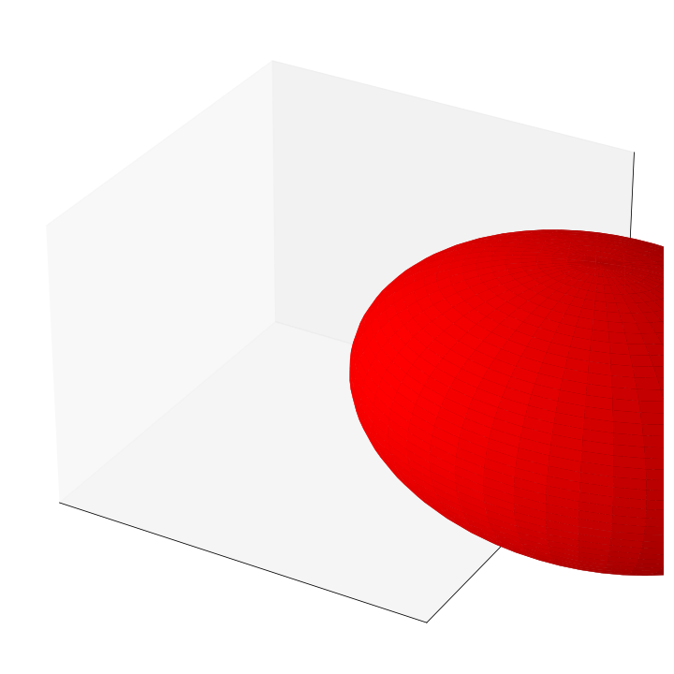
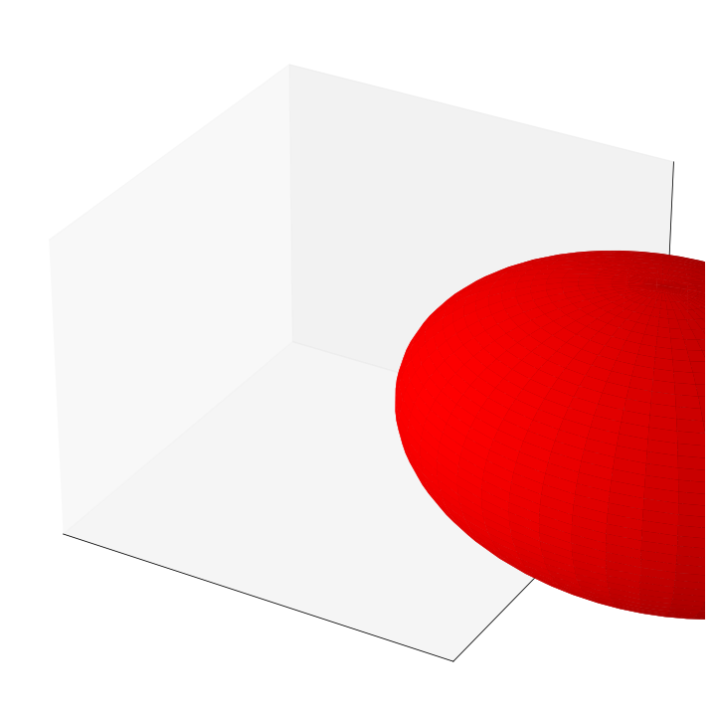
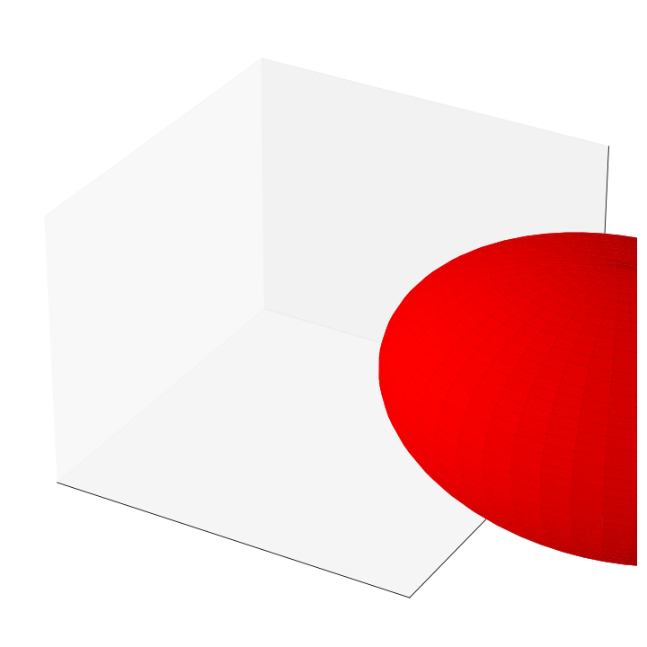
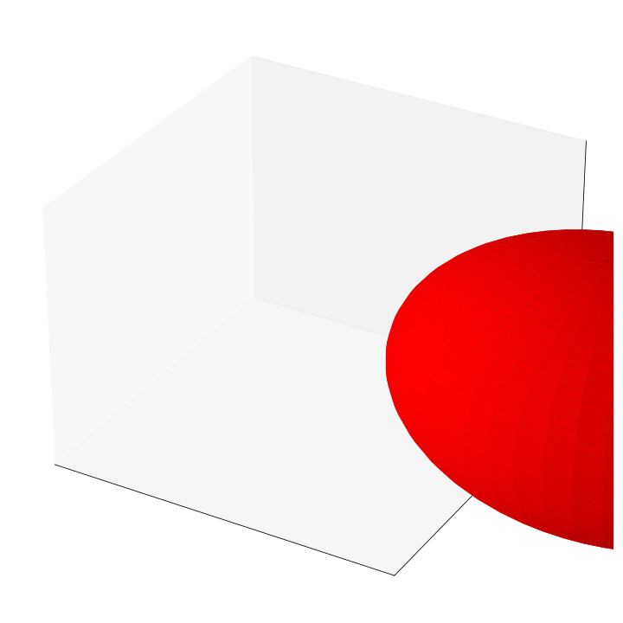
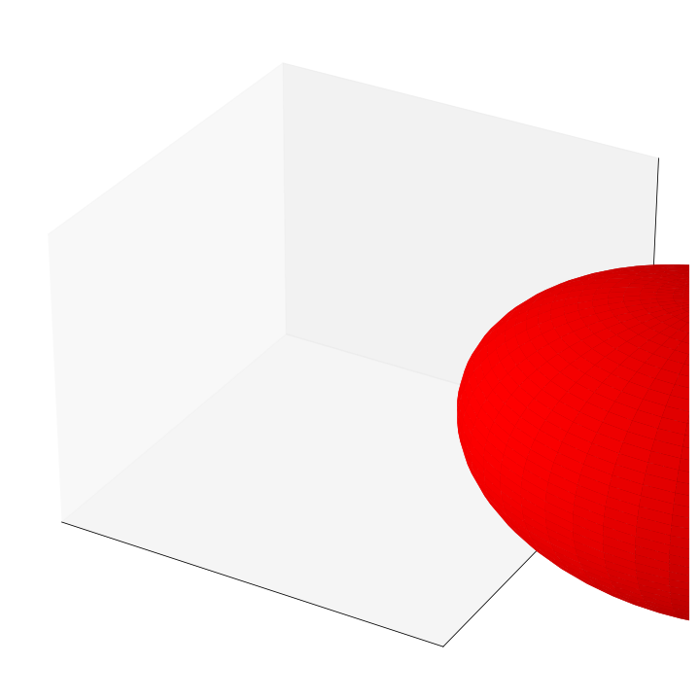
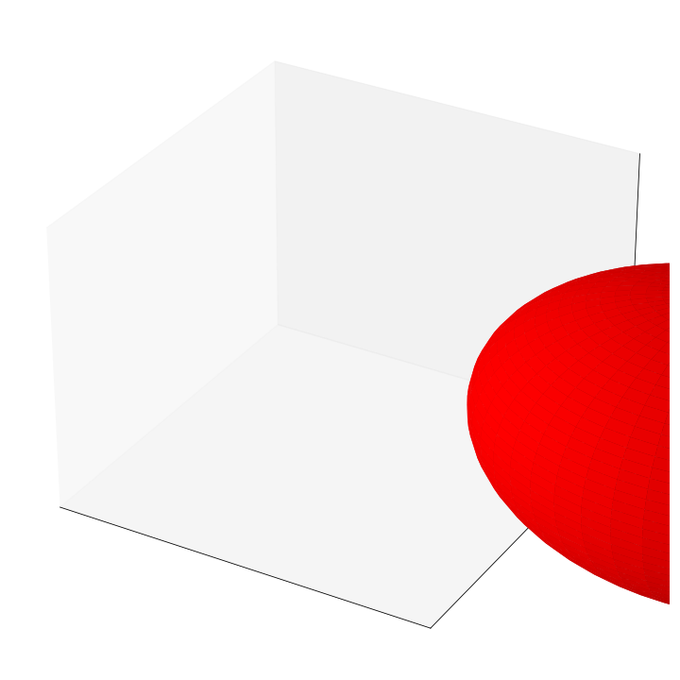
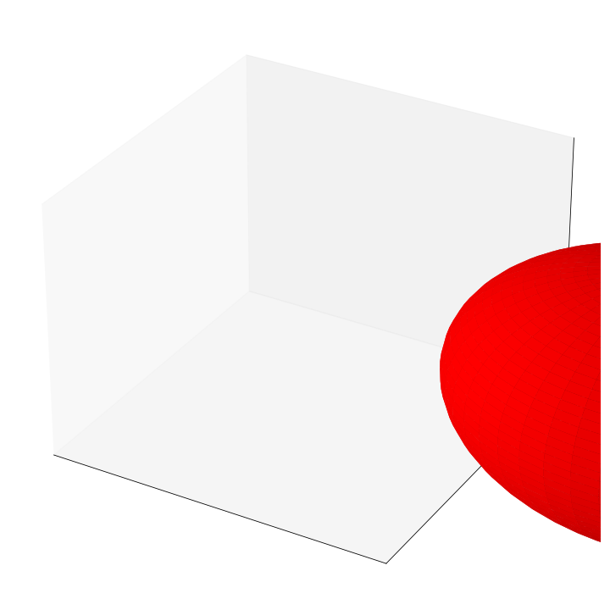
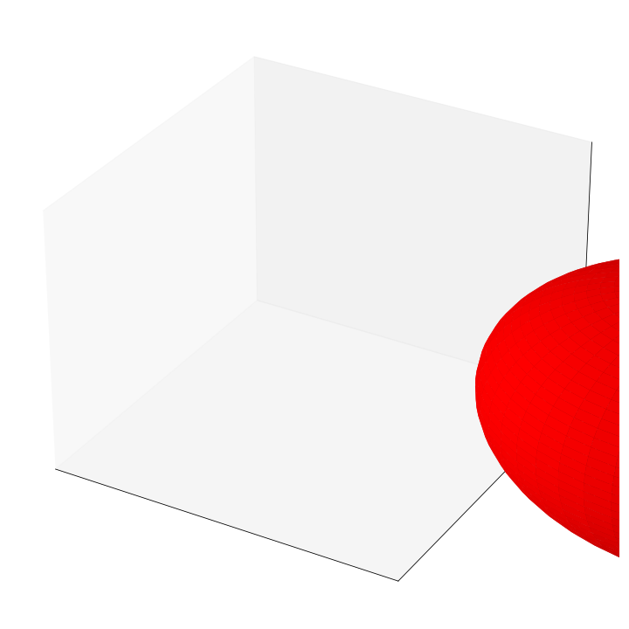
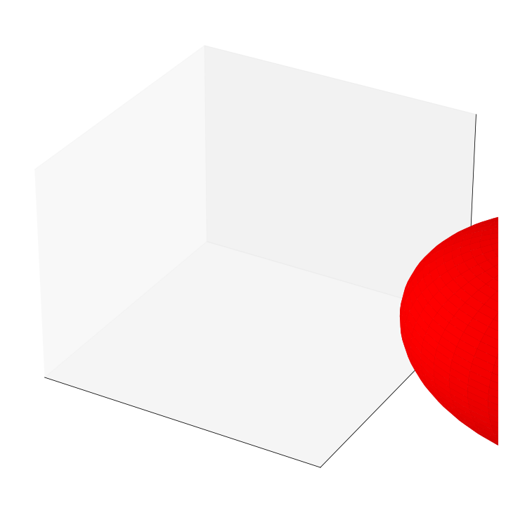
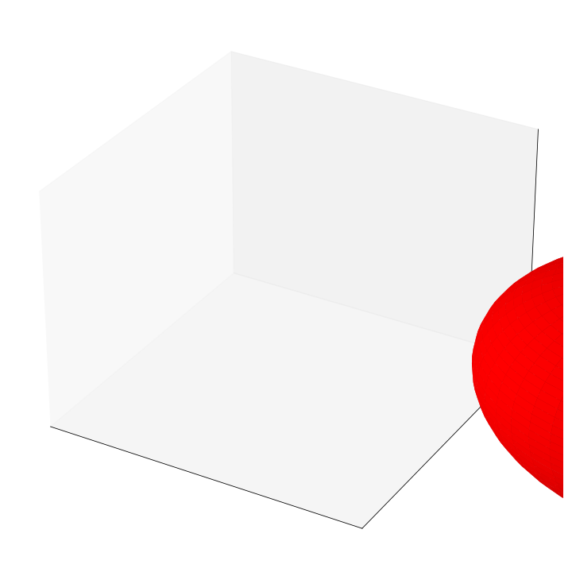
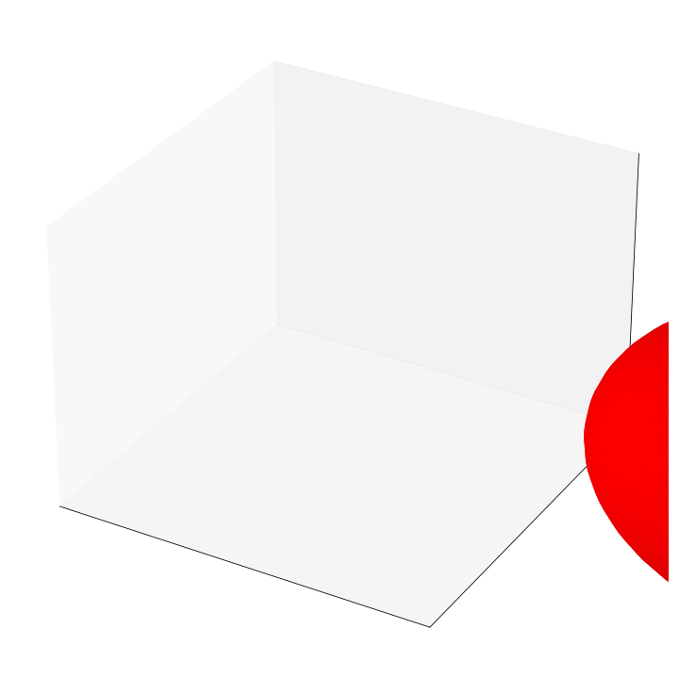
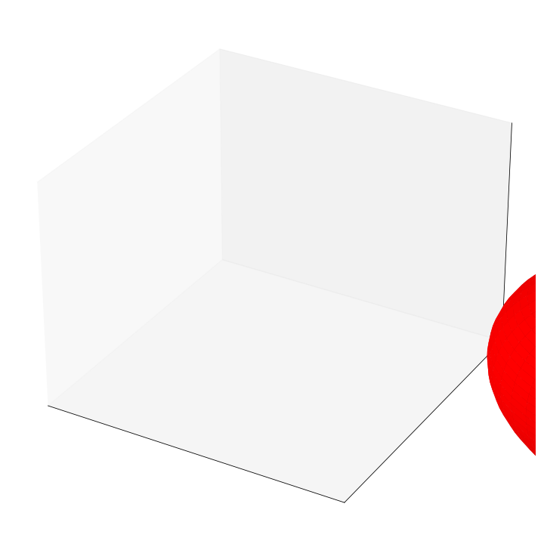
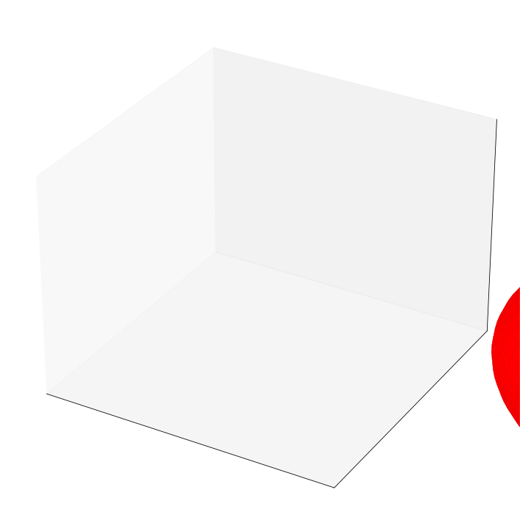
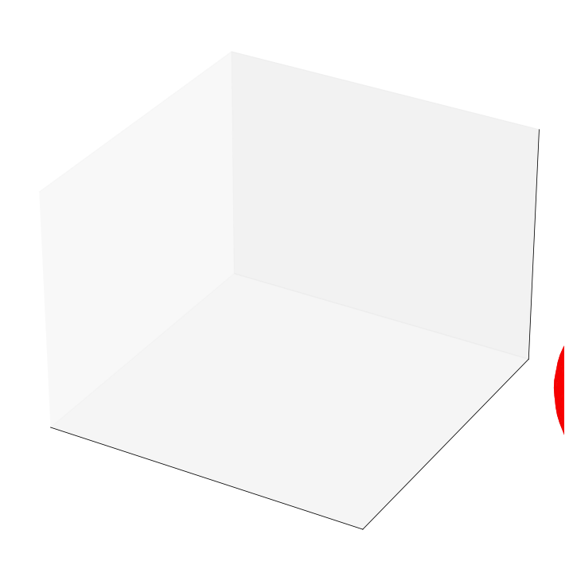
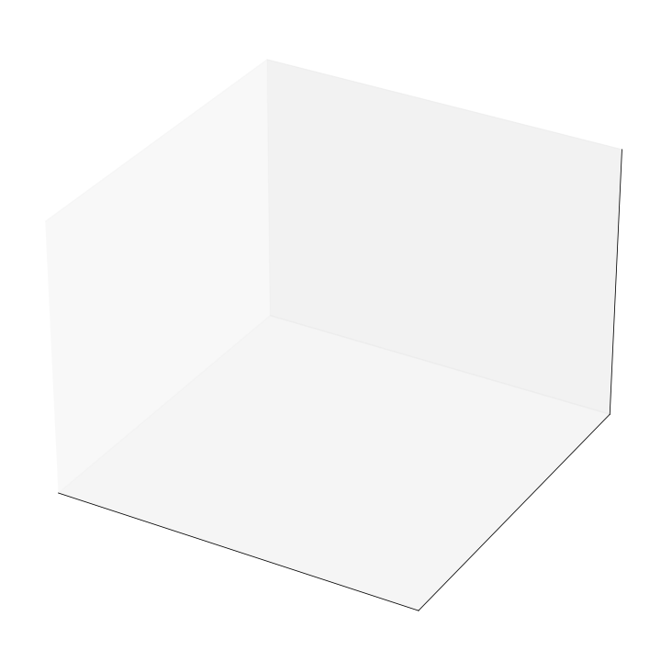

Slide 29
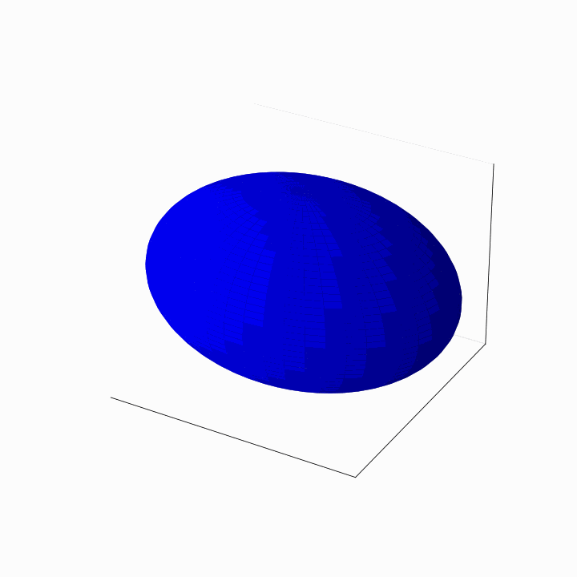
Notes:
Gouraud shading

Slide 30
3D
Blender

Slide 31
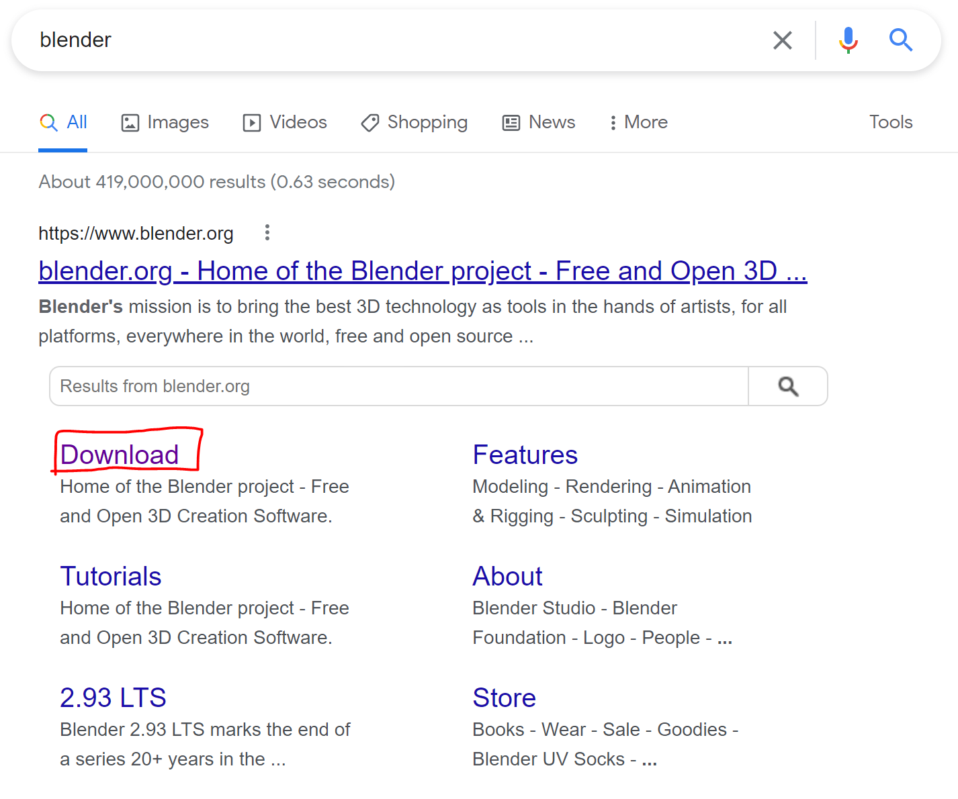
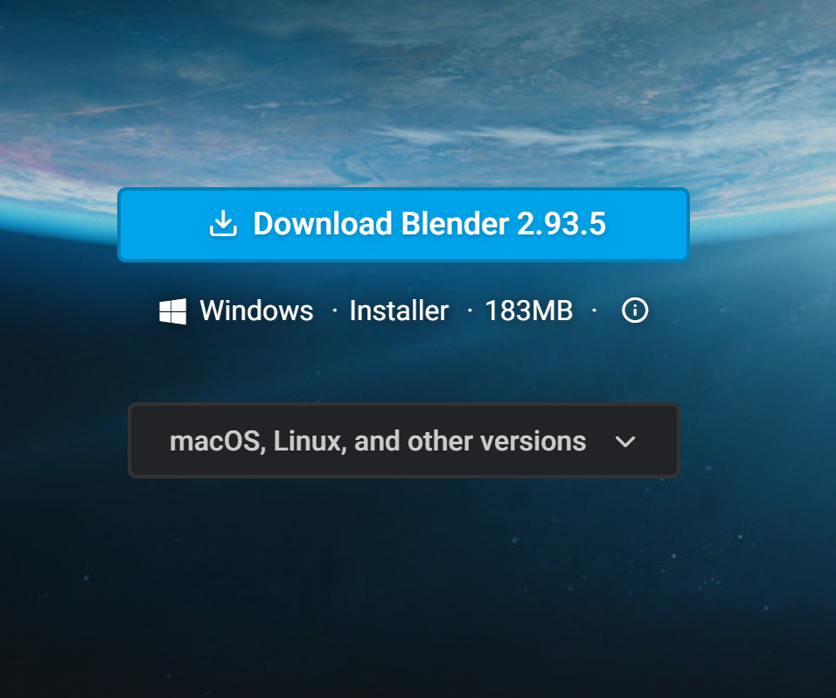
To download Blender:
Search blender in your browser
And click on “download“
3. You can download it for your computer’s operating system

Slide 32
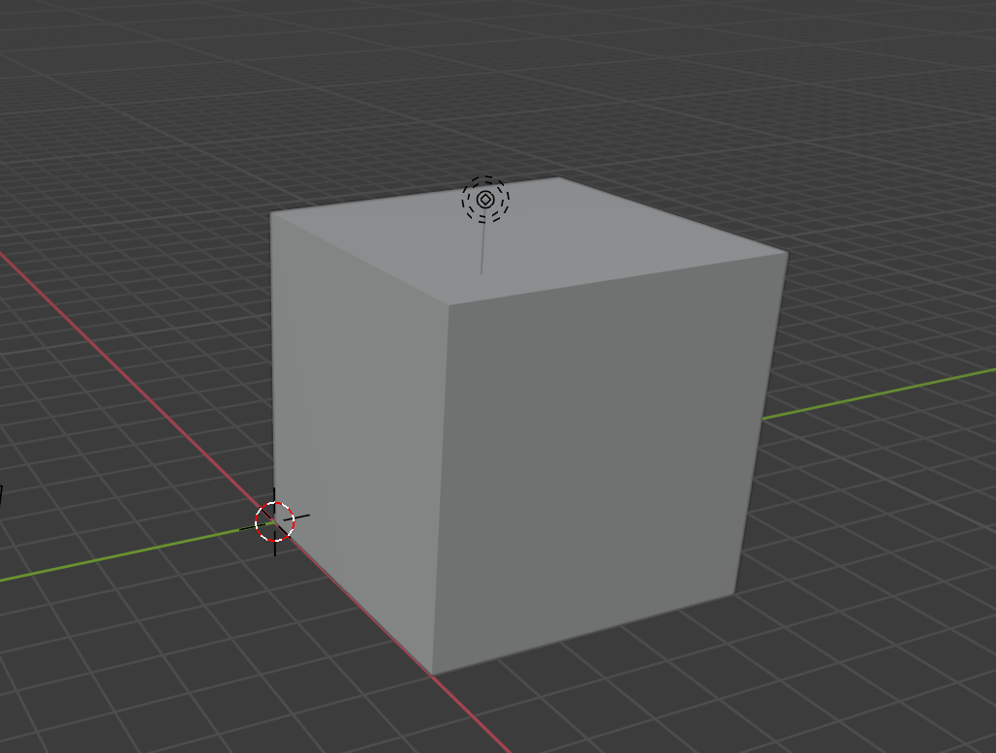
import bpy verts = [(0,0,0),(0,5,0),(5,5,0), (5,0,0),(0,0,5),(0,5,5),(5,5,5),(5,0,5)] faces = [(0,1,2,3), (7,6,5,4),(0,4,5,1),(1,5,6,2),(2,6,7,3), (3,7,4,0)] mymesh = bpy.data.meshes.new("Cube") myobject = bpy.data.objects.new("Cube", mymesh) myobject.location = bpy.context.scene.cursor.location bpy.context.collection.objects.link(myobject) mymesh.from_pydata (verts, [], faces) mymesh.update (calc_edges=True)
Notes:
import bpy
verts = [(0,0,0),(0,5,0),(5,5,0), (5,0,0),(0,0,5),(0,5,5),(5,5,5),(5,0,5)]
faces = [(0,1,2,3), (7,6,5,4),(0,4,5,1),(1,5,6,2),(2,6,7,3), (3,7,4,0)]
mymesh = bpy.data.meshes.new("Cube")
myobject = bpy.data.objects.new("Cube", mymesh)
myobject.location = bpy.context.scene.cursor.location
bpy.context.collection.objects.link(myobject)
mymesh.from_pydata (verts, [], faces)
mymesh.update (calc_edges=True)

Slide 33
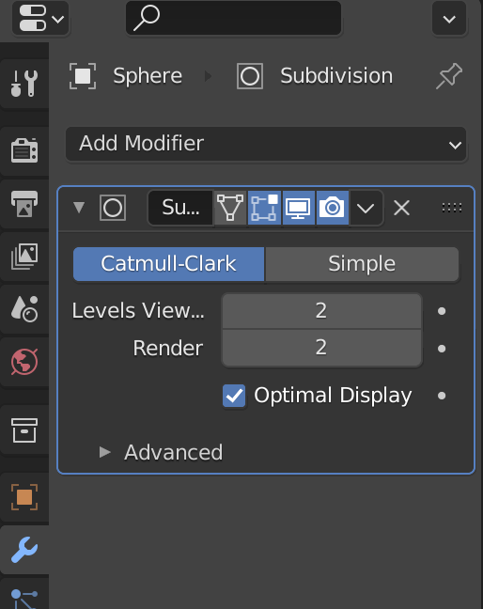
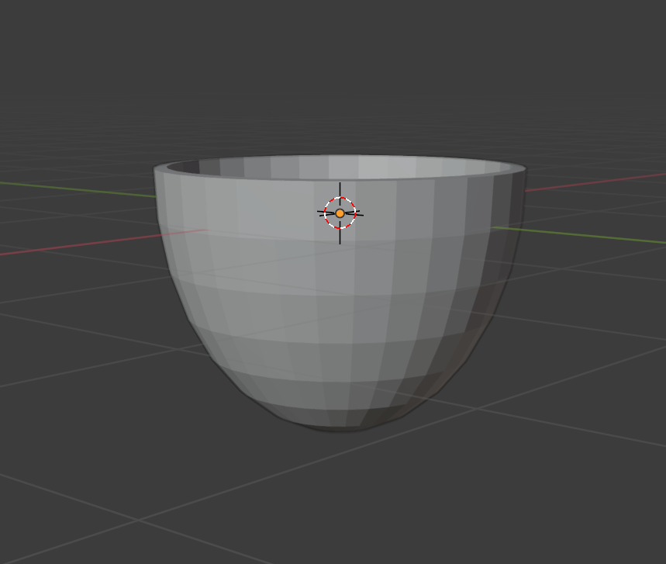
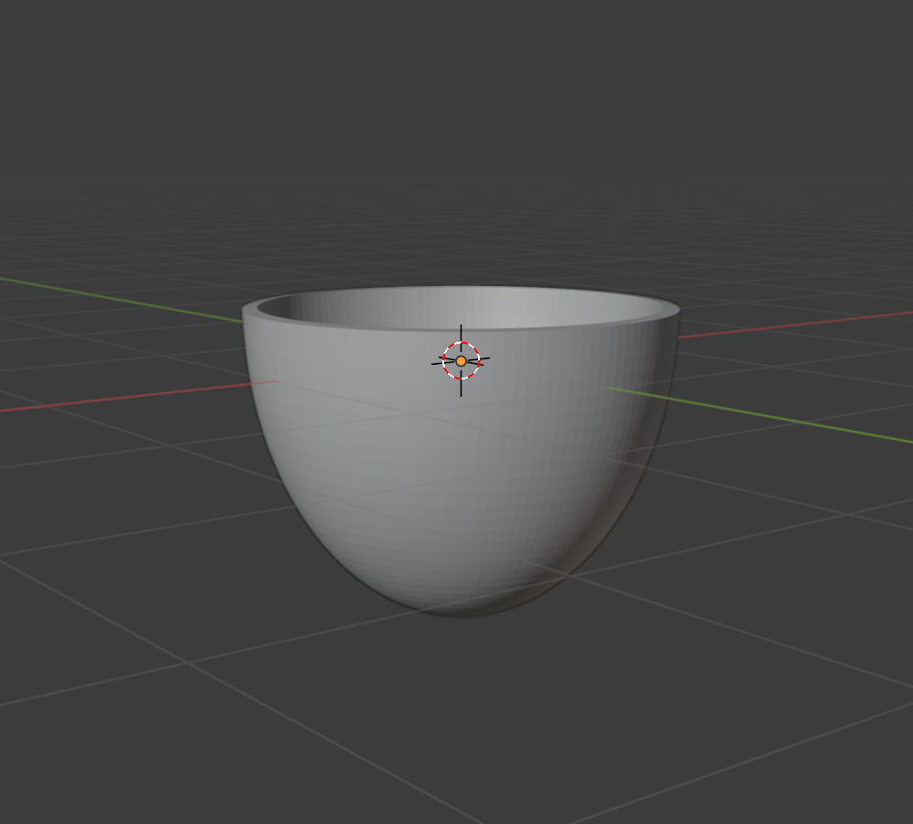
Subdivision
Before Subdivision
After Subdivision

Slide 34
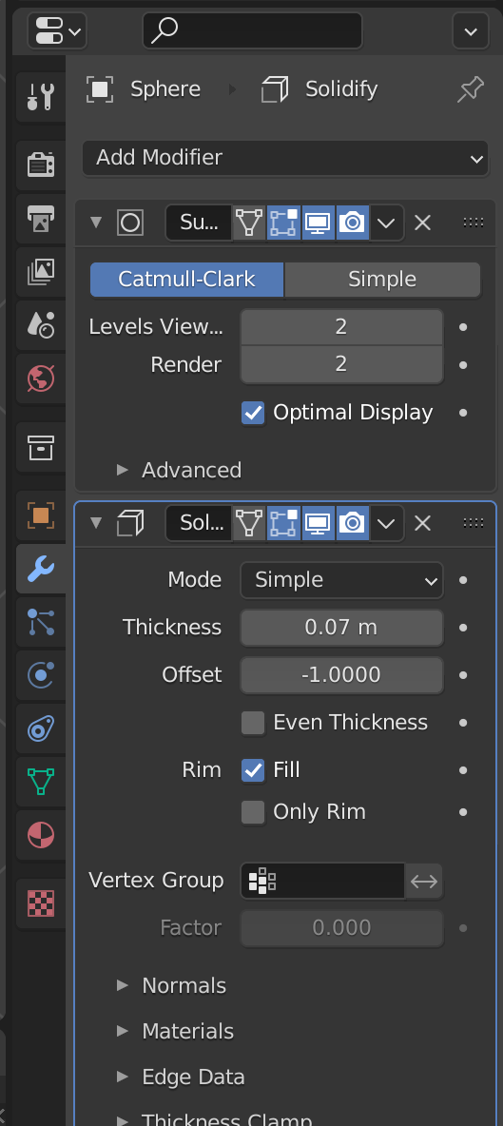


Solidify
Before Solidify
After Solidify

Slide 35




Selecting vertex
Selecting edge
Selecting face

Slide 36

Human Example

Slide 37
Thank You~

